Slide 1
E-COMMERCE BUSINESS (EDA) INSIGHTS PRESENTAION
BY EDEH MARY

Slide 2
PROJECT OVERVIEW
This project involves performing Exploratory Data Analysis (EDA) on an e-commerce store’s past data to uncover trends and patterns in customer behavior, sales performance, and business efficiency. The goal is to derive meaningful insights that will help the business optimize its operations, improve customer satisfaction, and increase profitability.
The analysis will focus on several key areas, including customer demographics, purchase behavior, loyalty, pricing strategies, marketing effectiveness, and return rates. By exploring these aspects, I aim to provide data-driven recommendations that will enhance decision-making and business growth.

Slide 3
Key Insights from Analysis & Recommendations

Slide 4
Key Insights from Analysis & Recommendations
Implement Smarter Discount Policies by offering discounts mainly on low-return-rate products to protect profit margins.
Minimize return risks by improving product descriptions and customer decision-making.

Slide 5
Key Insights from Analysis & Recommendations
LEVERAGE ON PEAK SHOPPING DAYS & HOURS:
Targeted Promotions: Implement discounts, or free shipping offers specifically for Tuesdays and Sundays.
Inventory & Staffing: Ensure sufficient stock levels and staff availability to handle increased order volumes on these peak days.

Slide 6
Key Insights from Analysis & Recommendations
Enable direct shopping via social media platforms (Instagram, TikTok, Facebook) where influencers promote products.
Partner with high-social-media-influence customers by offering exclusive referral discounts to their followers.

Slide 7
Key Insights from Analysis & Recommendations
Offer discounts based on spending levels to encourage larger purchases. Example:
Spend $100, Get 10% Off
Spend $200, Get 15% Off
Spend $500, Get 20% Off

Slide 8
Key Insights from Analysis & Recommendations
Ensure detailed and accurate product descriptions to reduce mismatch in customer expectations.
Use 360-degree product images and videos to give a better preview before purchase.
Implement conditional returns (e.g., stricter policies for frequently returned products).

Slide 9
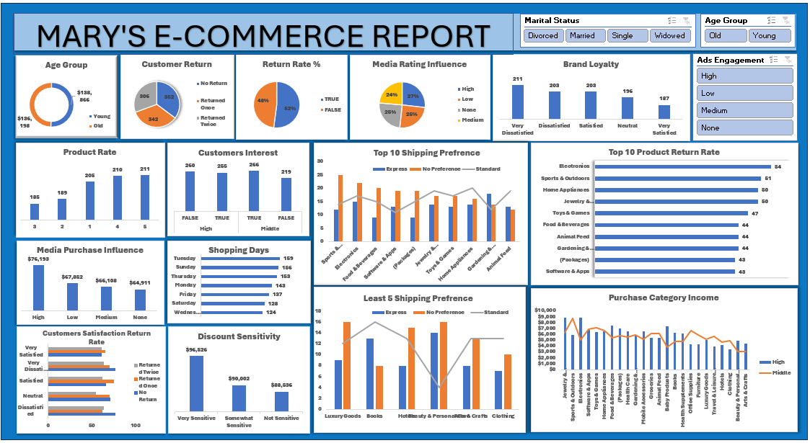

Slide 10
CONCLUSION
By aligning product promotions with customer demographics, enhancing satisfaction to foster loyalty, managing returns on discounted purchases, optimizing shipping for high-demand items, leveraging peak shopping periods, partnering with influencers, and improving product descriptions, the business can drive higher sales, reduce costs, and increase customer retention. Implementing these strategies will create a more efficient, customer-centric, and profitable e-commerce operation.
THANK
YOU

